Slide 1
“Catch A Match”
Group-2
Project Final Review

Slide 2
Agenda
Introduction
Gale-Shapley Algorithm
Terms to Know
Working Principle
Forecasting our Idea into Other Fields
Process which User goes through
User Perspective

Slide 3
Introduction

Slide 4
About the Project…
What is “Catch a Match” ?
1
Why is it special compared to others ?
2
How easy it is to be implemented ?
3
What are its scopes in the future ?
4
What are the components involved ?
5

Slide 5

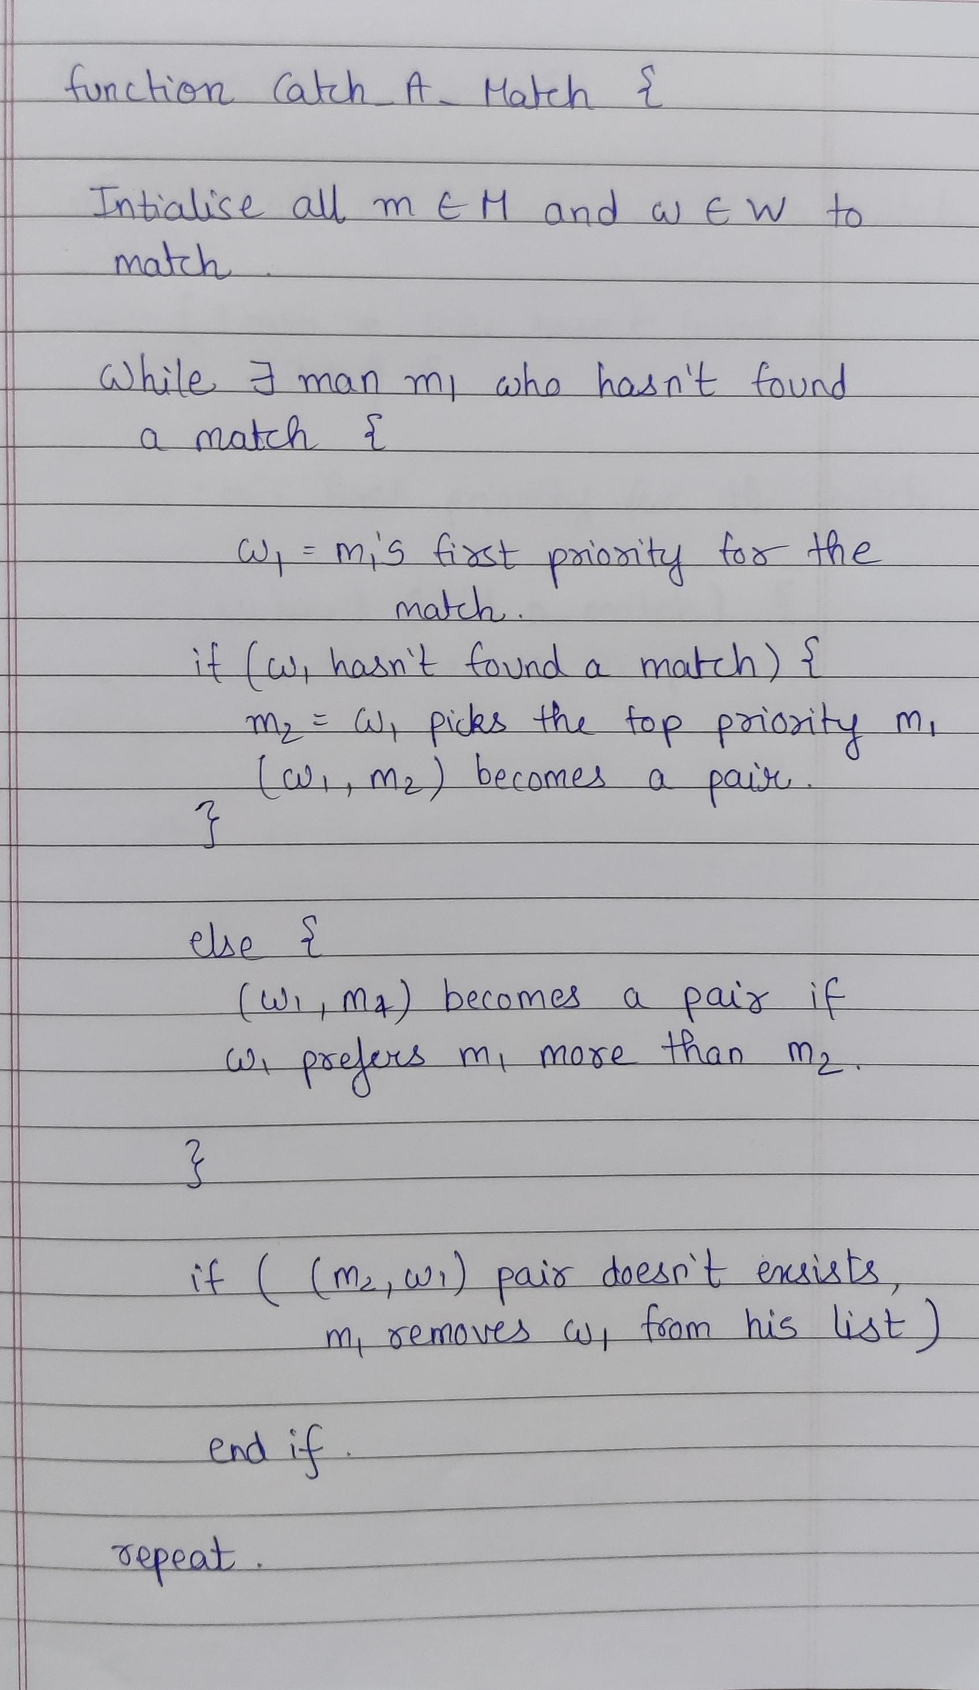
Gale Shapley Algorithm

Slide 6
About the Algorithm

Slide 7
Terms to Know
A matching is perfect if it has a size of |V| / 2, where V denotes the number of vertices.
The weight of matching M is the sum of the weights on the edges in M.
A minimum weight matching for Graph M is a perfect matching for M with minimum weight.
Given a matching M, x and y (x – Boy; y – Girl) form a rogue couple, if they prefer each other over their mates in M.
A matching is stable if there are no Rogue Couples.

Slide 8
Working Principle
We have n boys and n girls, each boy and girl have their own ranked preference list.
The boy would choose the first prioritised girl from the list who are not paired. (Initially all the girls are not paired), so the boy selects the first girl from the priority list.
The girls having atleast one boy picks a favourite (higher priority) and rejects the lower priority boy.
The boy who got rejected by a particular girl, removes the girl’s name from the priority list.
This process is continued until all the boys and girls are paired.

Slide 9
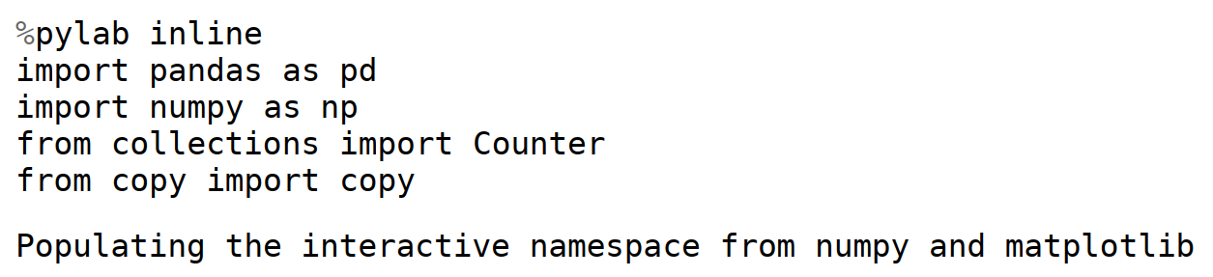
Code for the Gale-Shapley Algorithm

Slide 10
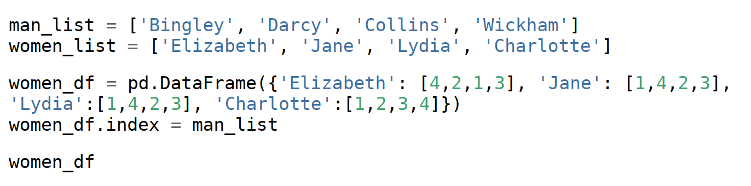
Input used in the Code

Slide 11
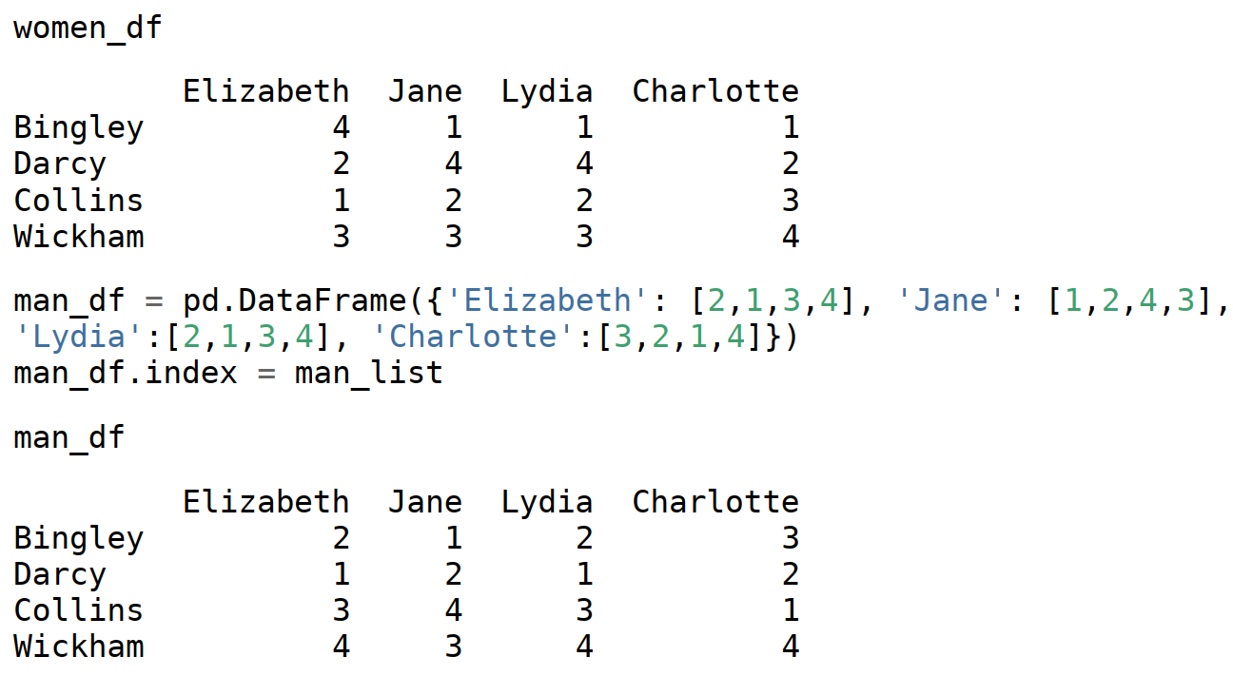
Input used in the Code

Slide 12
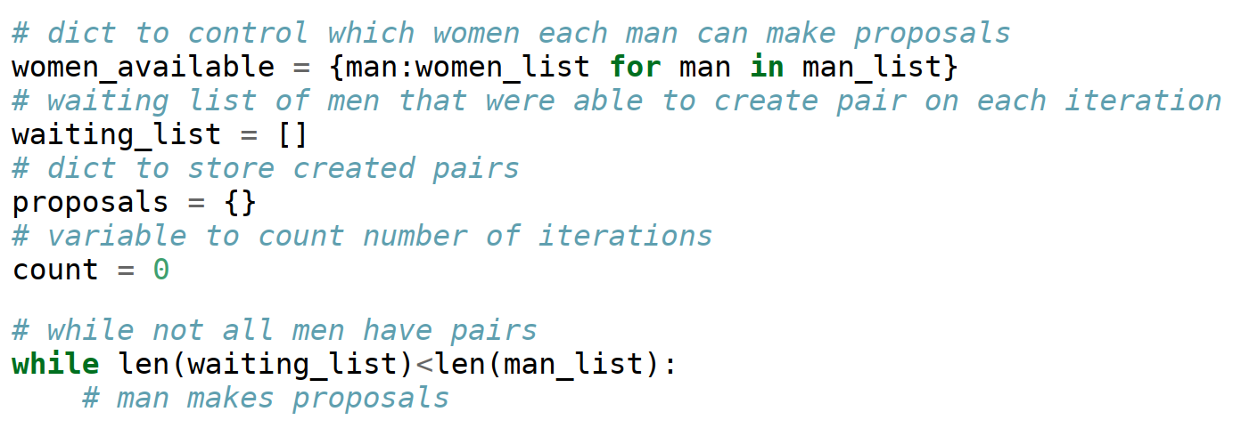
Priority List

Slide 13
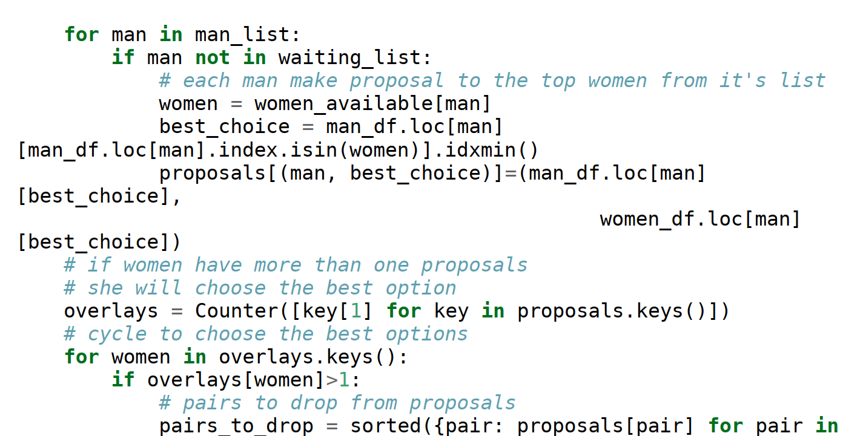
Gale-Shapley Algorithm

Slide 14
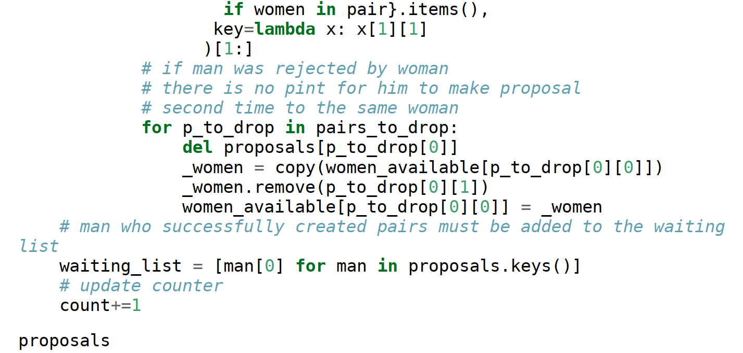
Gale-Shapley Algorithm

Slide 15
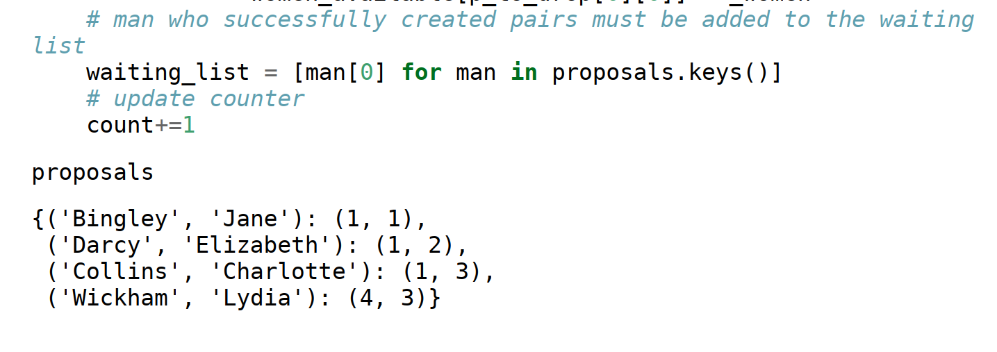
Output of the Code

Slide 16
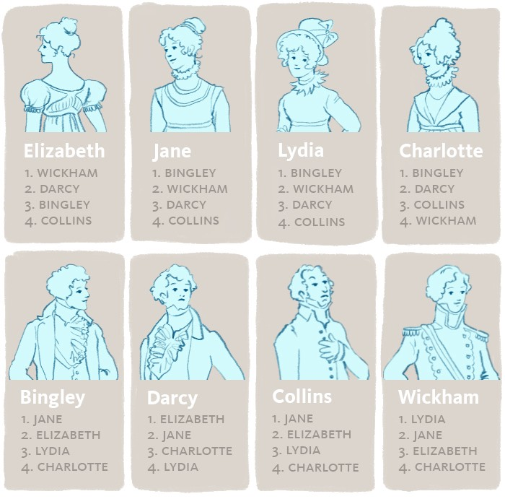
Let’s go through an Example

Slide 17
Video Demonstration

Slide 18
Forecasting our Idea into Other Fields
The Match-making concept not only being limited to matching couples, it can also be used in other fields like:
Assigning new doctors to the Hospitals
Pairing students to Public Schools
Helping Transplant patients find a match
Matching players in the Tournaments of games

Slide 19
Process which User goes through

Slide 20
User Guidelines
The user opens the app or website called “Catch A Match”.
The information of the user will be taken (For example, if the user is a male, then, he will have to enter his Gender, Height, Weight and a Profile pic along with his contact details).
Later, the information of the girls available will be popped onto his screen (as in the example we are considering the user to be a male)
Then the user will be prompted to enter the Preference List.
After a few time, the result of the matching will be displayed to him along with the contact details of the matched person.

Slide 21




Team Members
Ashutosh
Patel
Shubhankar
Gadad
Dev
Kapadia
Pavan
Kumar
Venkata
Bhaskara
Salome
Rao

Slide 22


Thank You

